Slide 1
Anomaly Detection in ICSs using SNN
Final Project Presentation
Michael Kaminer
2025

Slide 2
Table of Content:
Abstract
Introduction
Literature Review
Methods
Background
Related Work
Data Description
Experiments
Results & Discussion
Conclusion & Future Work

Slide 3


Abstract:
Industrial Control Systems (ICS) are essential for managing critical infrastructure, including power grids, water treatment plants, and manufacturing facilities. However, their increasing connectivity to external networks exposes them to cyber threats and operational anomalies. Traditional anomaly detection methods, such as statistical models and machine learning algorithms, often struggle with high-dimensional data, adaptive adversaries, and real-time processing constraints.

Slide 4
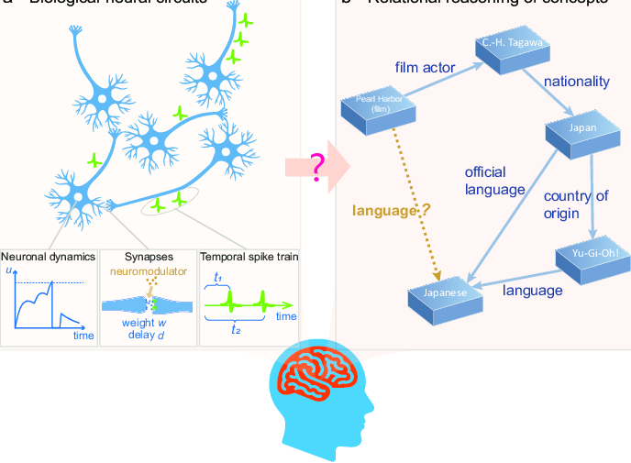

Abstract:
Spiking Neural Networks (SNN) offer a biologically inspired approach to anomaly detection, leveraging event-driven computations and temporal coding to enhance efficiency and adaptability.
This literature review explores existing methodologies for anomaly detection in ICS, evaluates the application of SNN in this domain, and identifies key challenges and opportunities for future research. By synthesizing findings from recent studies, this work aims to provide insights into the feasibility and effectiveness of SNN-based anomaly detection for securing industrial environments.

Slide 5
Introduction
Industrial Control Systems (ICS) are the backbone of modern critical infrastructure, enabling automation and real-time monitoring in industries such as energy, water supply, and manufacturing. economic losses, and threats to public safety.

Slide 6
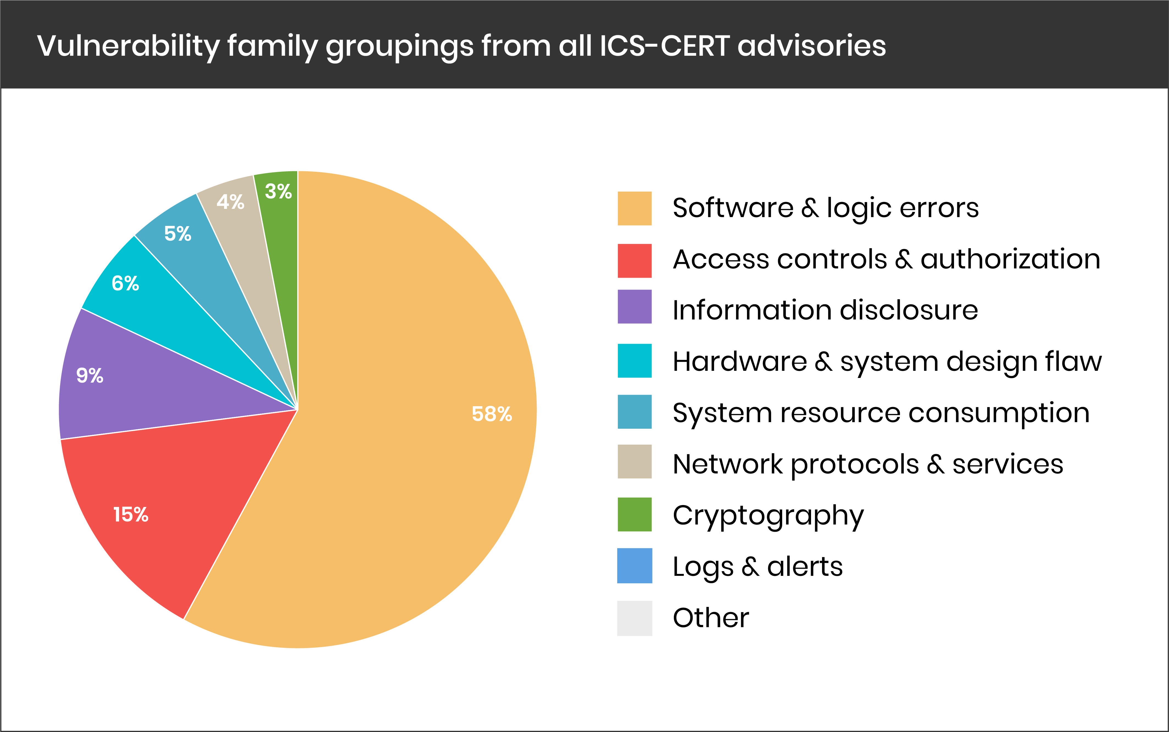
Literature Review

Slide 7
References:
[1] K. Stouffer, S. Lightman, V. Pillitteri, M. Abrams, and A. Hahn, Guide to Industrial Control Systems (ICS) Security: Supervisory Control and Data Acquisition (SCADA) Systems, Distributed Control Systems (DCS), and Other Control System Configurations such as Programmable Logic Controllers (PLC), NIST Special Publication 800-82, Rev. 2 (Initial Public Draft), National Institute of Standards and Technology, 2014.
[2] Y. Hu, A. Yang, H. Li, Y. Sun, and L. Sun, “A survey of intrusion detection on industrial control systems,” International Journal of Cyber Security and Digital Forensics, first published online Aug. 17, 2018.
[3] W. Knowles, D. Prince, D. Hutchison, J. F. P. Disso, and K. Jones, “A survey of cyber security management in industrial control systems,” Computers & Security, Mar. 2015.
[4] A. M. Y. Koay, R. K. L. Ko, H. Hettema, and K. Radke, “Machine learning in industrial control system (ICS) security: Current landscape, opportunities and challenges,”. May, 2022. p.380(p.4 pdf)
[5] Chandola, V., Banerjee, A., and Kumar, V. 2009. Anomaly detection: A survey. ACM Comput. Surv. 41, 3, Article 15 (July 2009), 58 pages. DOI=10.1145/1541880.1541882 http://doi.acm.org/10.1145/1541880.1541882
[6] Guansong Pang, Chunhua Shen, Longbing Cao, and Anton van den Hengel. 2021. Deep Learning for Anomaly Detection: A Review. ACM Comput. Surv. 54, 2, Article 38 (March 2021), 38 pages. https://doi.org/10.1145/3439950
[7] Antiy Security Response. (2016, March 16). Comprehensive Analysis Report on Ukraine Power System Attacks.
[8] https://www.ncsc.gov.bh/en/cyberwiser/ics.html
[9] https://www.trendmicro.com/en_us/research/22/c/an-in-depth-look-at-ics-vulnerabilities-part-1.html
[10] J. D. Nunes, M. Carvalho, D. Carneiro, and J. S. Cardoso, “Spiking neural networks: A survey,” IEEE Access, vol. 10, Jun. 2022, doi: 10.1109/ACCESS.2022.3179968.
[11] F. Ponulak and A. Kasiński, “Introduction to spiking neural networks: Information processing, learning and applications,” Acta Neurobiologiae Experimentalis, vol. 71, pp. 409–433, 2011.
[12] J. Vreeken, Spiking Neural Networks: An Introduction, 2003.
[13] SWAT: A Spiking Neural Network Training Algorithm for Classification Problems John J. Wade, Liam J. McDaid, Jose A. Santos, and Heather M. Sayers
[14] https://snntorch.readthedocs.io/

Slide 8
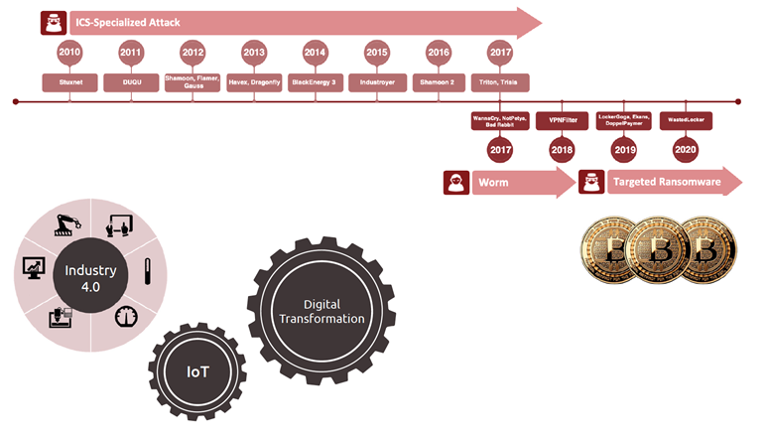
Background, Related Work

Slide 9
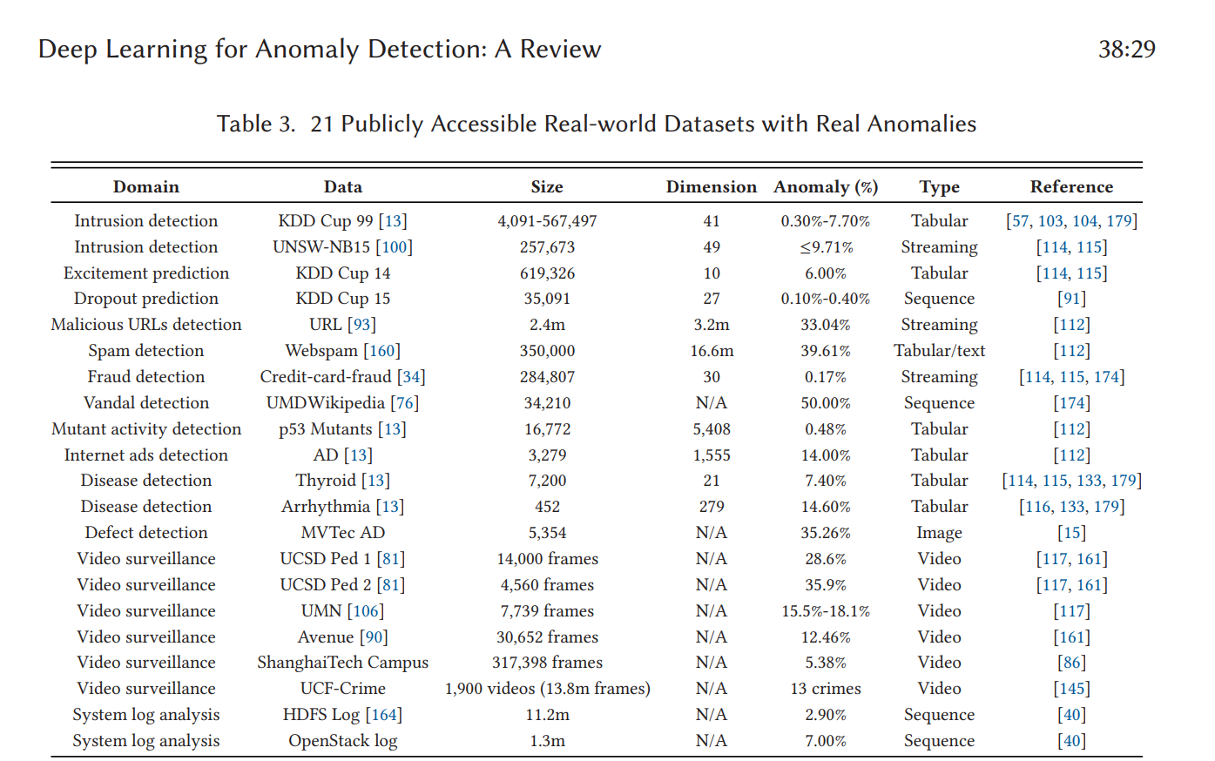
Related Work:
Datasets with Real Anomalies : One main obstacle to the development of anomaly detection is the lack of real-world datasets with real anomalies. Many studies evaluate the performance of their presented methods on datasets converted from popular classification data for this reason. This way may fail to reflect the performance of the methods in real-world anomaly detection applications.
[6]
[6]

Slide 10
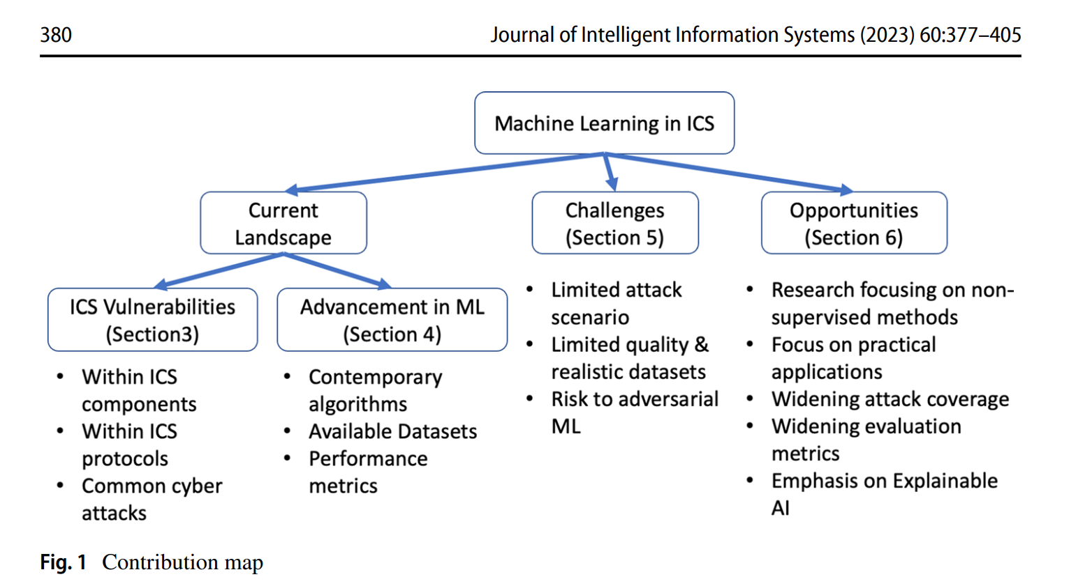
Related Work:
Existing surveys usually focus on specific types of ICS cyber attacks. [4]
[4]

Slide 11
Data Description
We use three benchmark datasets: SWaT, WADI, and Tennessee.
- SWaT: Secure Water Treatment dataset
- WADI: Water Distribution dataset
- Tennessee: ICS simulation dataset
Each dataset varies in size, feature types, and anomaly labels.

Slide 12
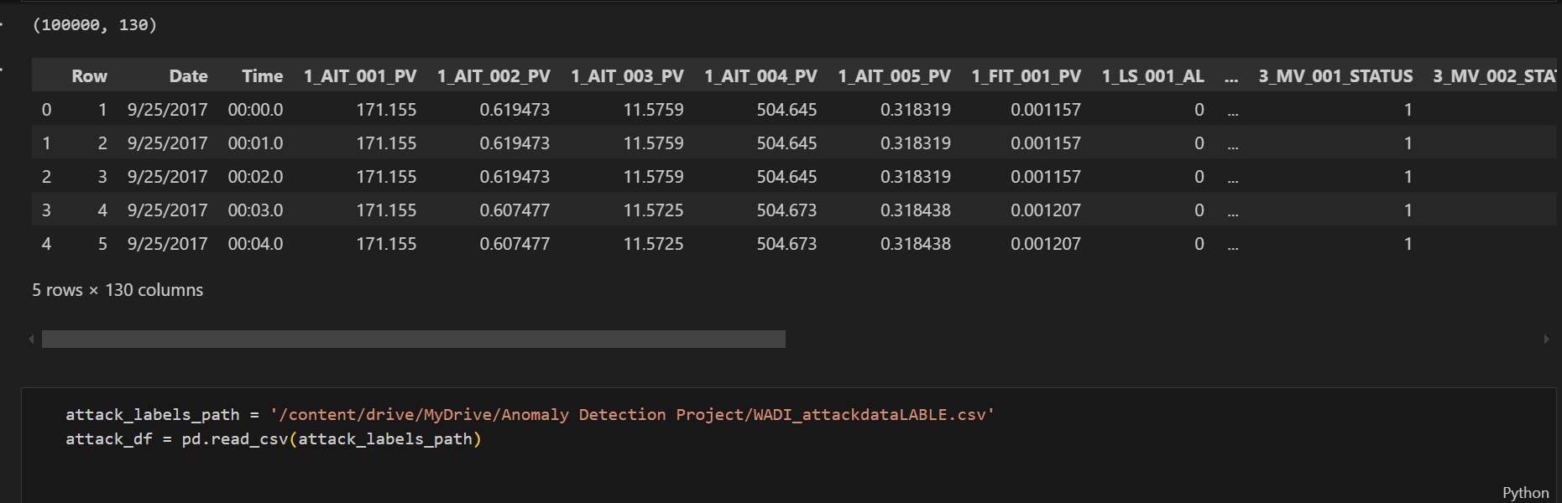
Data Description

Slide 13
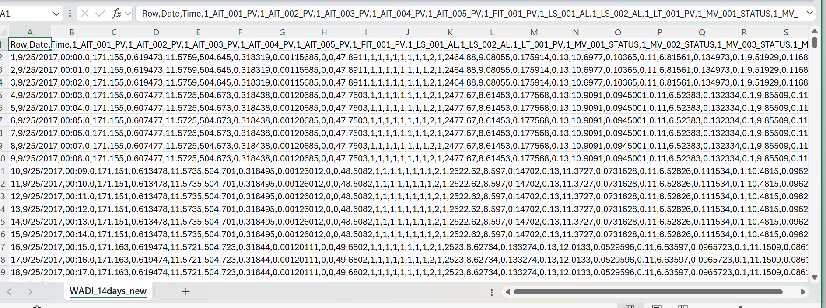
Data Description
(WADI Dataset)

Slide 14
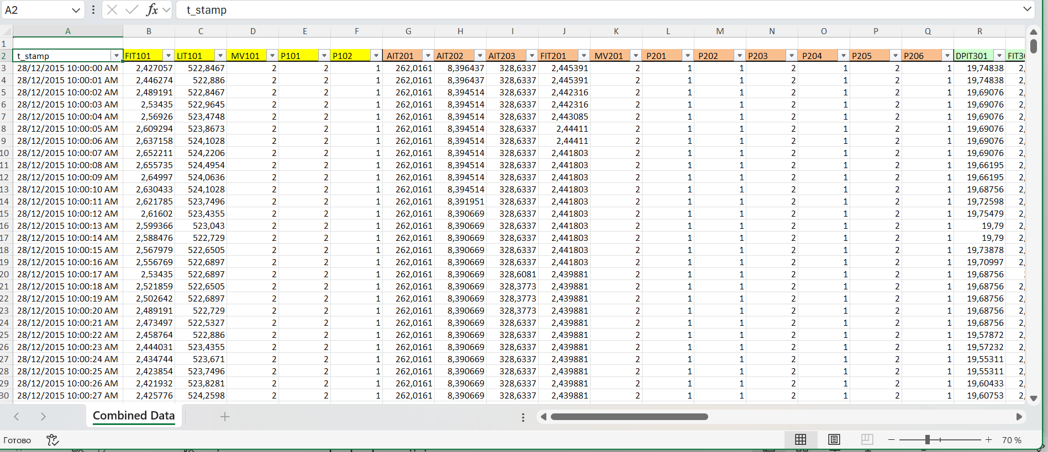
Data Description
(SWAT-Dataset)

Slide 15
Experiments
We evaluated multiple anomaly detection algorithms:
- Isolation Forest (on SWaT)
- One-Class SVM and Random Forest (on WADI)
- Future: SNN on all three datasets
Tools: scikit-learn, pandas, snntorch

Slide 16
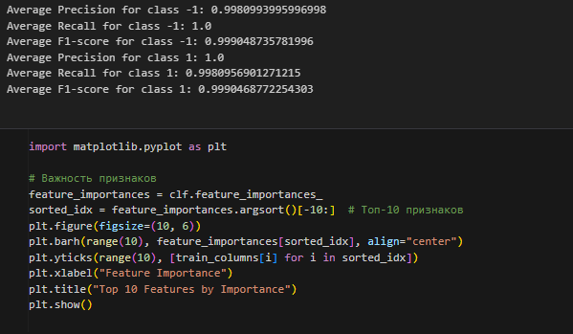
Experiments
(WADI)

Slide 17
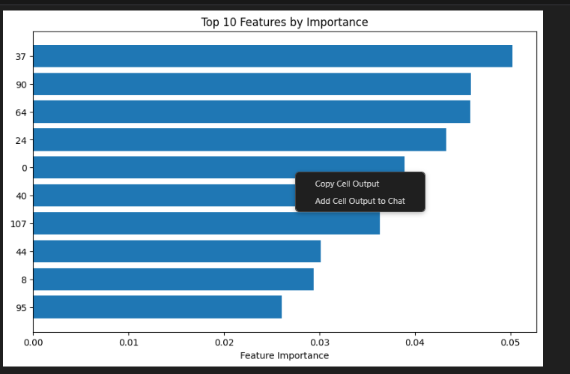
Experiments
(WADI)

Slide 18
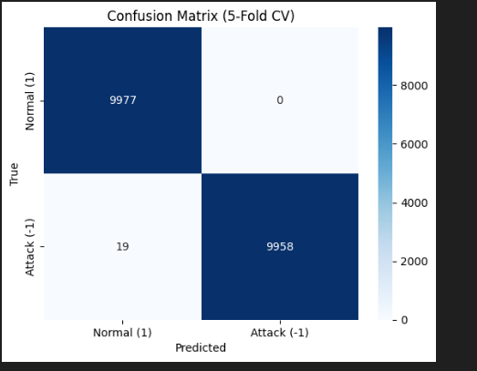
Experiments
(WADI)

Slide 19
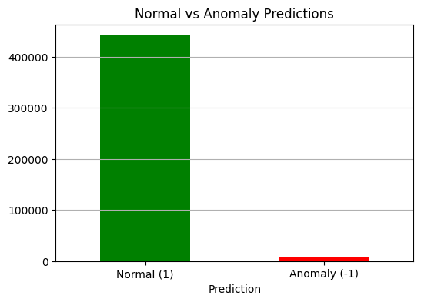
Experiments
(SWAT)

Slide 20
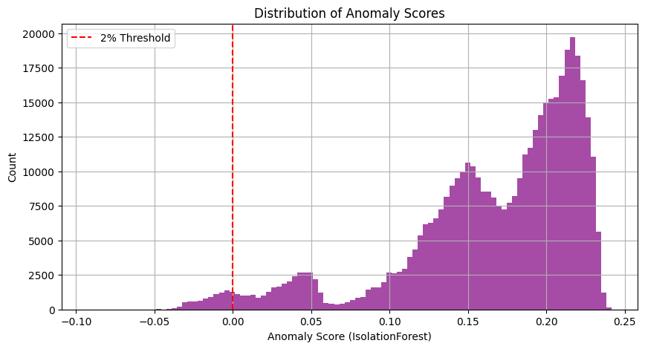
Experiments
(SWAT)

Slide 21
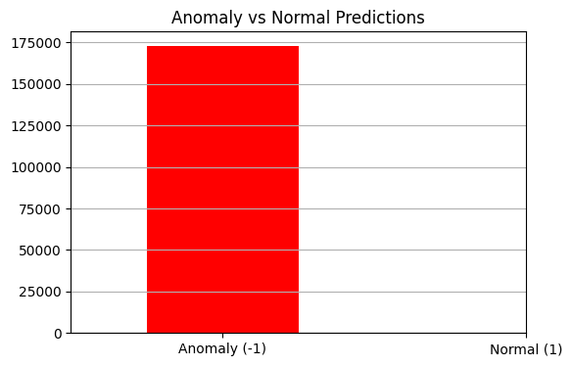
Experiments

Slide 22
Results & Discussion
Key Findings:
- One-Class SVM showed overfitting on WADI
- Isolation Forest performed well on SWaT with sparse anomalies
- Feature redundancy and class imbalance affected results
Next: Evaluate performance of SNN and compare to baseline models.

Slide 23
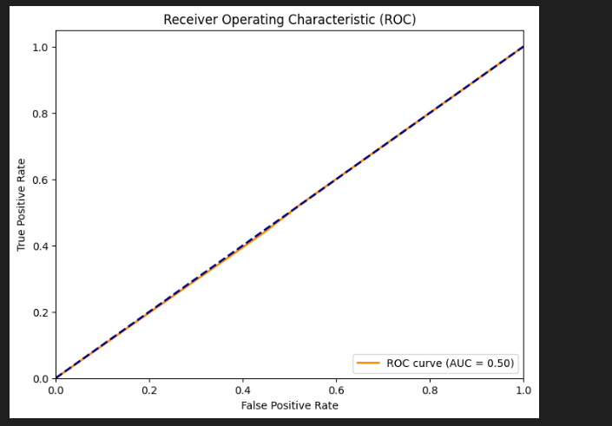
Results & Discussion (WADI)

Slide 24
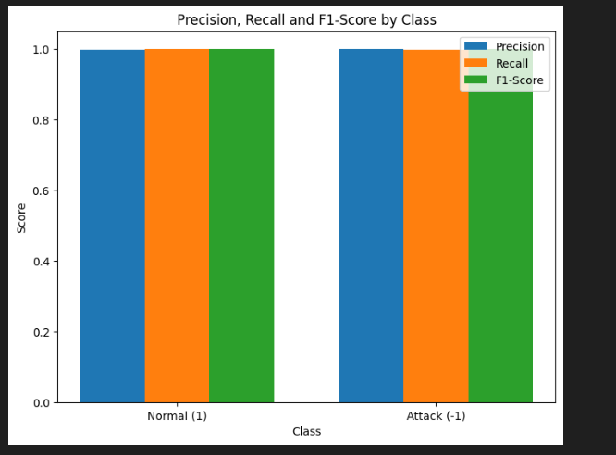
Results & Discussion (WADI)

Slide 25
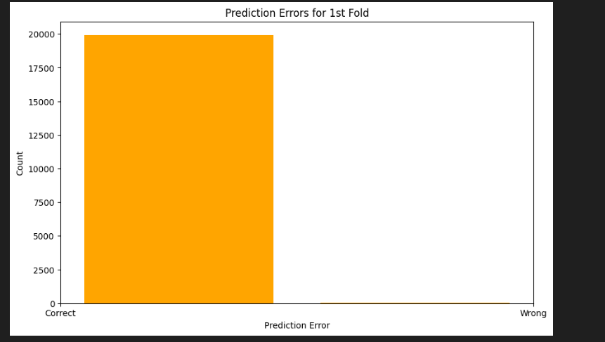
Results & Discussion (WADI)

Slide 26
Results & Discussion
Key Observations:
Isolation Forest on SWaT detected anomalies with relatively low false positives but showed sensitivity to threshold tuning.
One-Class SVM on WADI overfit easily due to high dimensionality and imbalanced class distribution.
Random Forest provided stronger baseline performance on WADI but lacked temporal awareness.
Initial tests showed that traditional models are sensitive to noise and redundant features in ICS data.

Slide 27
Results & Discussion
Preliminary Insights on SNN:
SNN architecture (tested on MNIST) demonstrates potential for learning sparse and temporal patterns.
Once integrated with ICS datasets, we expect SNN to handle time dependencies better than traditional models.
Challenges Identified:
Class imbalance and lack of labeled real-world anomalies hinder supervised evaluation.
Feature engineering remains crucial, especially for high-dimensional ICS datasets.

Slide 28
Conclusion & Future Work
Conclusion:
- Traditional models show limitations in ICS anomaly detection
- SNNs may offer better temporal representation and efficiency
Future Work:
- Full evaluation on Tennessee dataset
- Optimize and tune SNN architecture
- Explore real-time anomaly detection in ICS

